Slide 1


4. Final Testing and
Reporting

Slide 2
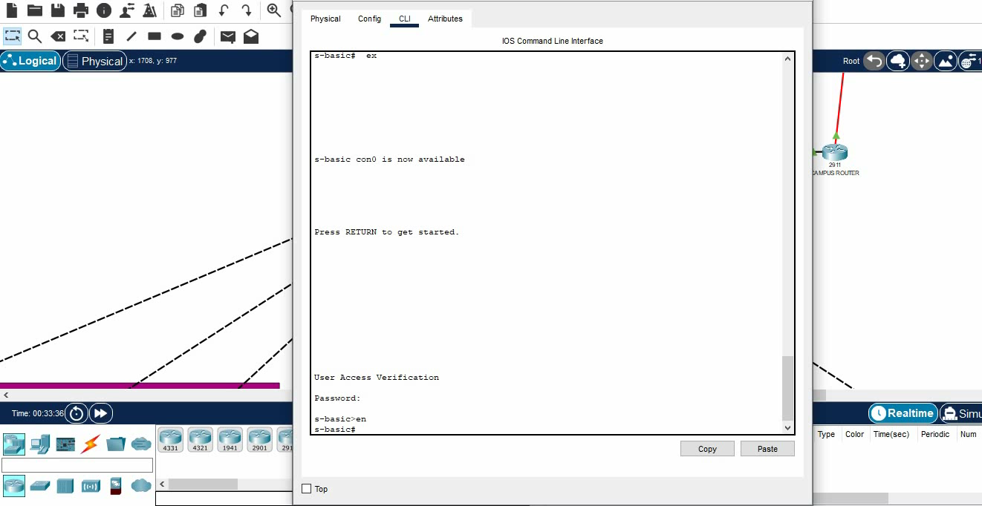
Port Security Configuration on Campus L3 Switch

Slide 3
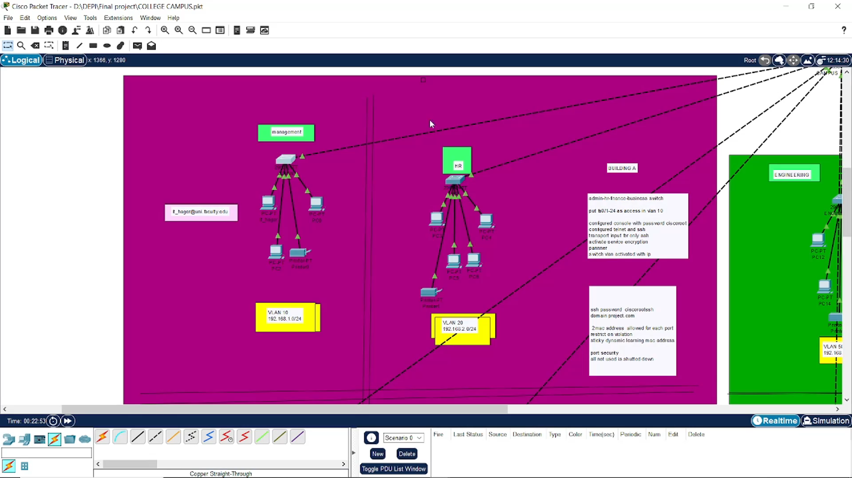
Port Security Testing:

